Slide 1
Agents as Intentional Systems
When explaining human activity, it is often useful to make statements such as the following:
  Janine took her umbrella because she believed it was going to rain.
  Michael worked hard because he wanted to possess a PhD.
These statements make use of a folk psychology, by which human behaviour is predicted and explained through the attribution of attitudes, such as believing and wanting (as in the above examples), hoping, fearing, and so on
The attitudes employed in such folk psychological descriptions are called the intentional notions

Slide 2
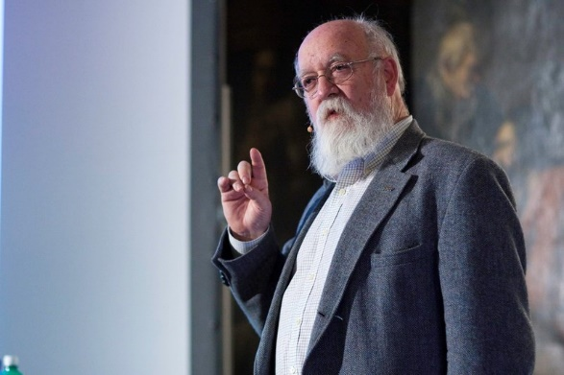
Agents as Intentional Systems
The philosopher Daniel Dennett coined the term intentional system to describe entities ‘whose behavior can be predicted by the method of attributing belief, desires and rational acumen’
Image: Viktorbuehler (CC BY-SA 3.0 license)

Slide 3
Agents as Intentional Systems
Is it legitimate or useful to attribute beliefs, desires, and so on, to computer systems?

Slide 4
Agents as Intentional Systems
McCarthy argued that there are occasions when the intentional stance is appropriate:
‘To ascribe beliefs, free will, intentions, consciousness, abilities, or wants to a machine is legitimate when such an ascription expresses the same information about the machine that it expresses about a person. It is useful when the ascription helps us understand the structure of the machine, its past or future behavior, or how to repair or improve it. It is perhaps never logically required even for humans, but expressing reasonably briefly what is actually known about the state of the machine in a particular situation may require mental qualities or qualities isomorphic to them.’
J. McCarthy. Ascribing mental qualities to machines. Technical report, Stanford University AI Lab., 1978.

Slide 5
Agents as Intentional Systems
What objects can be described by the intentional stance?
As it turns out, more or less anything can. . . consider a light switch:
  ‘It is perfectly coherent to treat a light switch as a (very cooperative) agent with the capability of transmitting current at will, who invariably transmits current when it believes that we want it transmitted and not otherwise; flicking the switch is simply our way of communicating our desires’.
But most adults would find such a description absurd!
Why is this?
Y. Shoham. Agent oriented programming. Technical report, Stanford Computer Science Dept., 1990.

Slide 6
Agents as Intentional Systems
The answer seems to be that while the intentional stance description is consistent,
  . . . it does not buy us anything, since we essentially understand the mechanism sufficiently to have a simpler, mechanistic description of its behavior. [Shoham, 1990]
Put crudely, the more we know about a system, the less we need to rely on animistic, intentional explanations of its behaviour
But with very complex systems, a mechanistic explanation of its behaviour may not be practicable
As computer systems become ever more complex, we need more powerful abstractions and metaphors to explain their operation — low level explanations become impractical. The intentional stance is such an abstraction
Y. Shoham. Agent oriented programming. Technical report, Stanford Computer Science Dept., 1990.

Slide 7
Agents as Intentional Systems
Dennett identifies different ‘grades’ of intentional system:
‘A first-order intentional system has beliefs and desires (etc.) but no beliefs and desires about beliefs and desires. …A second-order intentional system is more sophisticated; it has beliefs and desires (and no doubt other intentional states) about beliefs and desires (and other intentional states) — both those of others and its own’

Slide 8
Agents as Intentional Systems
This intentional stance is an abstraction tool — a convenient way of talking about complex systems, which allows us to predict and explain their behaviour without having to understand how the mechanism actually works
Now, much of computer science is concerned with looking for abstraction mechanisms (witness procedural abstraction, ADTs, objects,…)
So why not use the intentional stance as an abstraction tool in computing — to explain, understand, and, crucially, program computer systems?
Characterising agents as intentional systems provides us with a familiar, non-technical way of understanding & explaining agents.

